Slide 1
ATS 2020
Call for Late –Breaking Abstracts
Step-by-step instructions on how to submit an abstract
www.conference.thoracic.org

Slide 2
Table of Contents
Author Disclosure
Abstract Submission
Abstract Type- Late-Breaking Abstract
Title
Category- 4- Step Process for Selecting a Category
Presentation Preference
Authors & Study Groups
Abstract Affirmations
Presenter Affirmations
Clinical Trial Affirmations
Abstract Body & Image
Preview & Finish

Slide 3
Author Disclosure
Presenting author (submitter) must complete the author disclosure form
To begin your abstract submission, click on your name at the top right corner, and then Disclosure.
Make sure to complete PARTS 1-5 of the disclosure form. You must click on Save & Continue > Continue to Finalize > FINALIZE and SUBMIT to ATS to complete your author disclosure form.
Back to
Table of Contents

Slide 4
Author Disclosure
Presenting author (submitter) must complete the author disclosure form
Once you have finalized your author disclosure form, you may start your ATS 2020 abstract submission by clicking on Return to Dashboard in the top menu.
Back to
Table of Contents

Slide 5
Abstract Submission
Abstract Type- Scientific Abstract or Case Report
Begin your abstract submission by scrolling to the bottom of the dashboard, and selecting the appropriate abstract type.
Late-Breaking Abstracts- these abstracts must contain:
A descriptive title, list of authors and institutions;
An introduction/rationale to the study;
The methods used;
The results of the study including new data not previously published or presented at a major national or international meeting;
Conclusions of the study. It is not satisfactory to state: "The results will be discussed."
Back to
Table of Contents

Slide 6
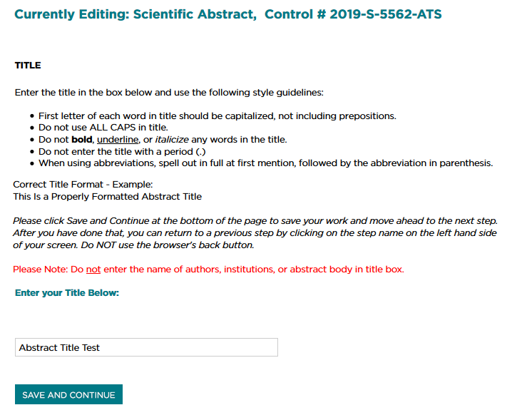
Abstract Submission
Title
Enter your title into the textbox. If your title contains special characters, subscripts, and/or superscripts, you may copy and paste your title from MS Word.
Make sure to follow all style guidelines when entering your abstract title.
Click on SAVE AND CONTINUE.
Back to
Table of Contents

Slide 7
Abstract Submission
Category- 4- Step Process for Selecting a Category
Step 1: Classification
Click Here for the List of Scientific Abstract Classifications
Step 2: Discipline
Select one of the following: Adult or Pediatric
Step 3: Subclassification
Select the best fit for the type of research reported in the abstract. Click here for more information on subclassifications.
Step 4: Reviewing Assembly
When submitting an abstract or case report, you will need to identify the Assembly by which you would like your abstract reviewed. Please click here for the list of assemblies and their descriptions.
Click on SELECT to begin the 4-step process
Your selections will appear on the screen. Click SAVE AND CONTINUE to continue to the next step
Back to
Table of Contents

Slide 8
Abstract Submission
Presentation Preference
Select one of the following options. The choice selected indicates the type of presentation that is preferred by the Presenting Author. However, final assignment is determined by the International Conference Committee.
There are two options:
Poster Only
Either Poster or Oral
Click SAVE AND CONTINUE to continue to the next step → Authors.
Back to
Table of Contents

Slide 9
Abstract Submission
Authors & Study Groups
Presenting Author
The person submitting the abstract will automatically be the Presenting Author.
The Presenting Author will be listed first and cannot be modified for any reason.
All institution and contact information will be pre-populated in the appropriate fields. Edit/update these fields if any of your details have changed. Fields marked with an asterisk (*) are required.
Click SAVE AND CONTINUE to add co-authors.
Back to
Table of Contents

Slide 10
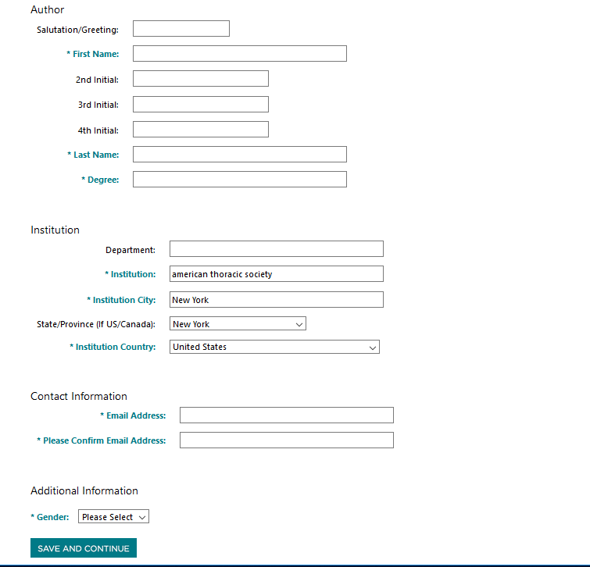
Abstract Submission
Authors & Study Groups
Co-Authors
Click Add Author to add co-author(s).
The system will first search for an existing profile before allowing a new profile to be created. Click on Add if a matching profile is found OR click on Enter your author here if there is no match.
Entering a new author’s information
All fields marked with an asterisk (*) are required.
Click SAVE AND CONTINUE to add author.
Continue these steps to add additional co-authors.
Back to
Table of Contents

Slide 11
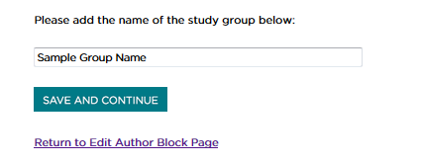
Abstract Submission
Authors & Study Groups
Study Groups
To add a study group, click on Add a Group.
Type in the name of the Study Group or Team.
Click SAVE AND CONTINUE.
Back to
Table of Contents

Slide 12
Abstract Submission
Authors & Study Groups
Change the order of authors listed
Click on Change the Order these Author(s) are listed
Choose the order for each author
NOTE: You CANNOT change the order of the presenting author (must be first author). The Study Group name must be listed last.
Click SAVE AND CONTINUE.
Once you have completed entering all authors and the order is correct, click on SAVE AND CONTINUE to continue to the next step → Abstract Affirmations.
Back to
Table of Contents

Slide 13
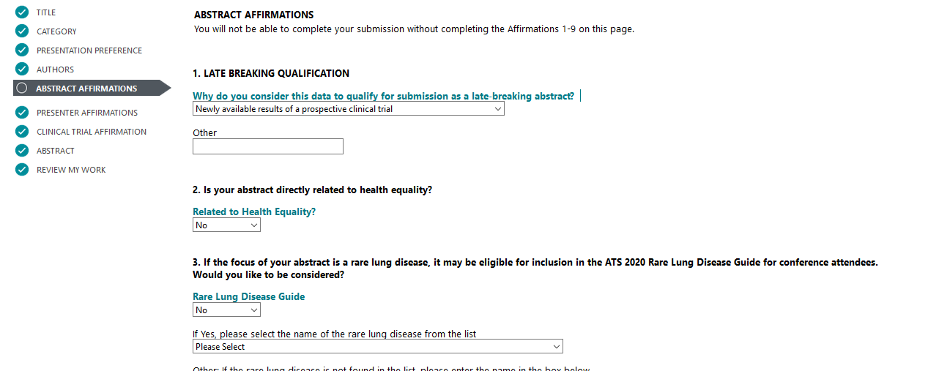
Abstract Submission
Abstract Affirmations
The submitter must complete abstract affirmations 1-9 to continue to the next step → Presenter Affirmations. Once complete, click SAVE AND CONTINUE.
You can always go back to a previous step by selecting it from the left menu.
Back to
Table of Contents

Slide 14
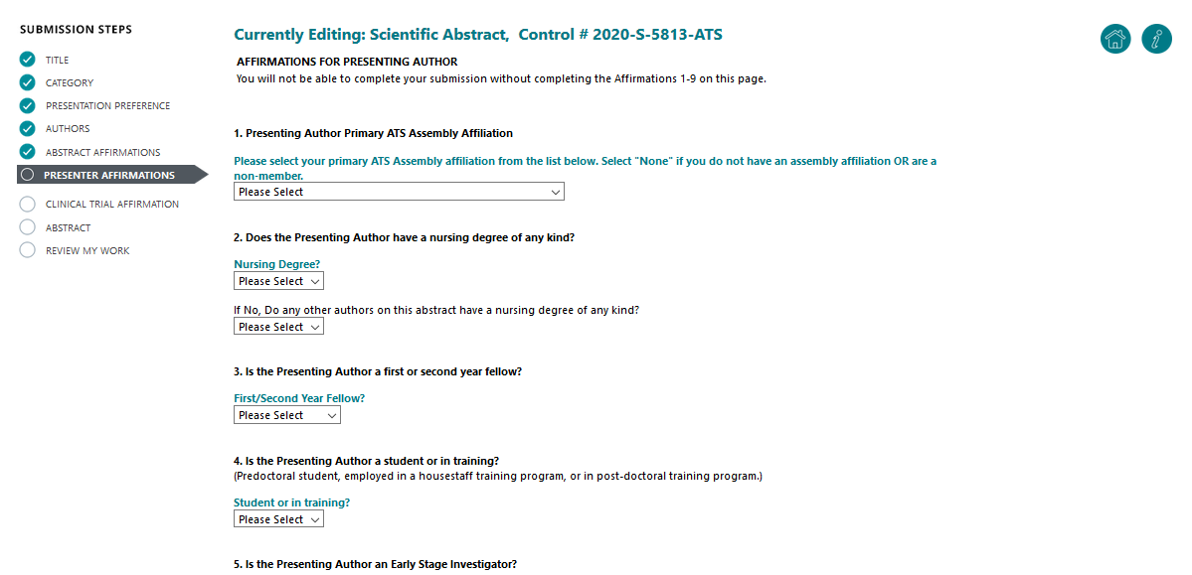
Abstract Submission
Presenter Affirmations
The submitter must complete presenter affirmations 1-9 to continue to the next step → Clinical Trial Affirmation. Once complete, click SAVE AND CONTINUE.
Back to
Table of Contents

Slide 15
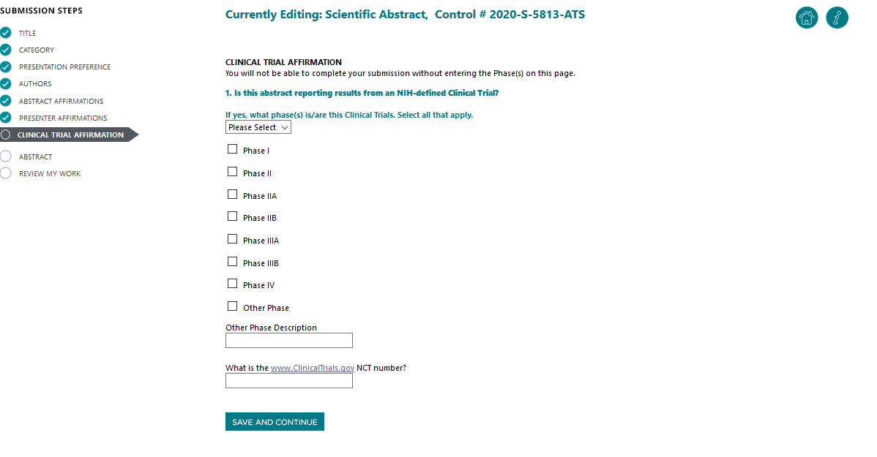
Abstract Submission
Clinical Trial Affirmations
The submitter must complete the Clinical Trial affirmation to continue to the next step → Abstract. Once complete, click SAVE AND CONTINUE.
Back to
Table of Contents

Slide 16
Abstract Submission
Abstract Body
You may type your abstract text directly into the system or upload a Word document, which will extract the text into the abstract body field.
To type directly, click on Enter Abstract Text
To upload, click on Upload a File Containing Your Abstract
Do not enter abstract title and authors in the abstract body
400 word limit (image, table, and spaces are not included in word count)
1 image per abstract. (Click here for instructions on how to upload a Table as an image.) To add an image, click on Add an Image.
Back to
Table of Contents

Slide 17
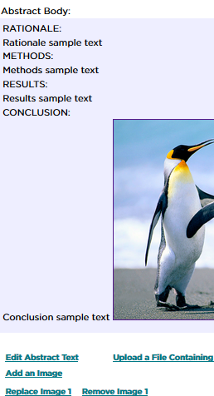
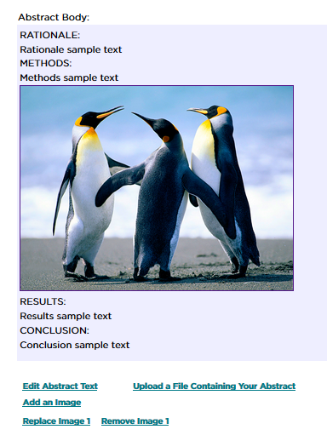
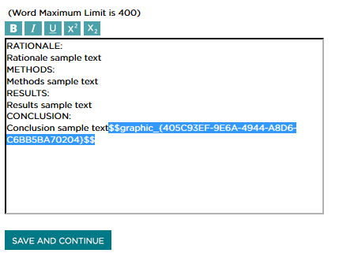
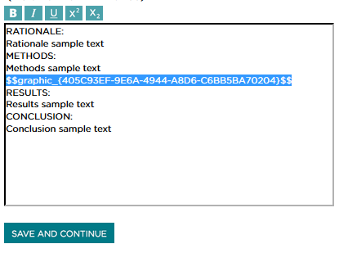
Abstract Submission
Abstract Body- Image
1 image per abstract. (Click here for instructions on how to upload a Table as an image.) To add an image, click on Add an Image. (JPG, JPEG, or GIF format only)
HOW TO MOVE AN IMAGE
If the image you have uploaded is not in the correct position, click on Edit Abstract Text.
Highlight the FULL text for the graphic (from the first 2 $$ to the last 2 $$). Press on Ctrl+X to cut the text. Select where you would like graphic to appear. Press Ctrl+V to paste. Click SAVE AND CONTINUE.
Note: Image/Graph must be legible for review. An image with multiple images will not be published with the abstract.
Back to
Table of Contents

Slide 18
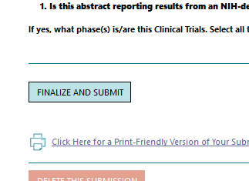
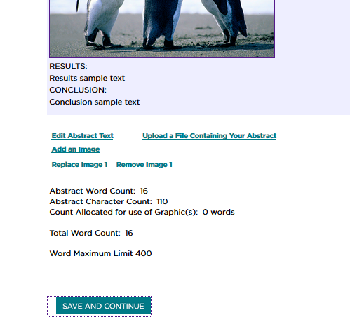
Abstract Submission
Preview & Finish
Once you have finished entering your Abstract Body, Click SAVE AND CONTINUE to review your work and submit your abstract
Carefully review your work. Scroll down and click on Finalize and Submit to submit payment.
Your submission is NOT complete until payment has been submitted and abstract is marked FINALIZED. If your abstract is marked COMPLETED, the abstract has NOT been successfully submitted. Please go back to submit payment and finalize.
Back to
Table of Contents

Slide 19
Abstract Submission
Preview & Finish
You can always go back to the homepage ( ) to access your abstracts and check submission statuses.
Status: Incomplete
Abstract is in progress and has NOT been successfully submitted.
Status: Complete
Abstract has been SUCCESSFULLY SUBMITTED.
To log out, click on your name at the top right corner, and then Logout
Back to
Table of Contents

